Slide 1
Unified Modelling Language (UML)
Dr. Samriddhi Sarkar
Assistant Professor Sr. Grade, SCOPE

Slide 2
Unified Modelling Language (UML diagrams)
UML diagrams are used to represent a system along with its main actors, roles, actions, classes.
UML diagrams are categorized into structural diagrams, behavioural diagrams
Structural diagrams are static view or structure of a system. It is widely used in the documentation of software architecture.
Behavioural diagrams are dynamic view of a system or the behaviour of a system, which describes the functioning of the system.

Slide 3
What is Unified Modeling Language (UML)?
a standard language for writing software blueprints, for visualization
UML may be used to visualize, specify, construct, and document the artifacts of a software-intensive system
software architects create UML diagrams to help software developers build the software
Simplifies the complex process of software design

Slide 4
Why to use UML?
Use graphical notation to communicate more clearly that natural language and code.
Quick understanding
Gives an overall view of a system
Lessens chances if conflicts
UML is dependent on any other language or technology

Slide 5
Types of UML diagram
Behavioural diagram (Shows the static part)
Class Diagram
Component diagram
Deployment Diagram
Object Diagram
Package
Behavioral Diagram
Use-case Diagram
Activity Diagram
State Diagram
Interaction
Interaction diagram
Sequence Diagram
Communication (Collaboration)

Slide 6
PART 1
Class Diagram

Slide 7
Class Diagram
Class diagrams provide a high-level overview of a system’s design
To model classes, including their attributes, operations, and their relationships and associations with other classes,2 UML provides a class diagram
class diagram provides a static or structural view of a system
Following are the purpose of class diagrams given below:
It analyses and designs a static view of an application.
It describes the major responsibilities of a system.
It is a base for component and deployment diagrams.
It incorporates forward and reverse engineering.

Slide 8
What is “class”?
In object-oriented programming (OOP), a class is a blueprint or template for creating objects.
Objects are instances of classes, and each class defines a set of attributes (data members) and methods (functions or procedures) that the objects created from that class will possess.
The attributes represent the characteristics or properties of the object, while the methods define the behaviors or actions that the object can perform

Slide 9
Class Diagram
Vital components of a Class Diagram: The class diagram is made up of three sections:
Upper Section (class name)
Middle Section (attributes)
Lower Section (Methods)
Upper Section: The upper section encompasses the name of the class.
A class is a representation of similar objects that shares the same relationships, attributes, operations, and semantics.
Some of the following rules that should be taken into account while representing a class are given below:
Capitalize the initial letter of the class name.
Place the class name in the center of the upper section.
A class name must be written in bold format.
The name of the abstract class should be written in italics format.

Slide 10
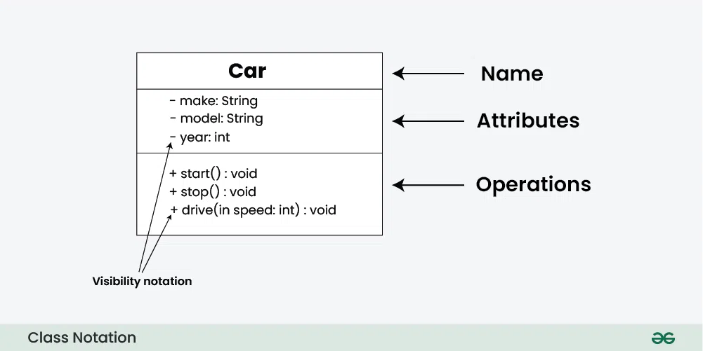
Class diagram
Middle Section: The middle section constitutes the attributes, which describe the quality of the class.
The attributes have the following characteristics:
The attributes are written along with its visibility factors, which are public (+), private (-), protected (#), and package (~).
The accessibility of an attribute class is illustrated by the visibility factors.
A meaningful name should be assigned to the attribute, which will explain its usage inside the class.
Lower Section: The lower section contain methods or operations.
The methods are represented in
the form of a list, where each
method is written in a single line.
It demonstrates how a class
interacts with data

Slide 11
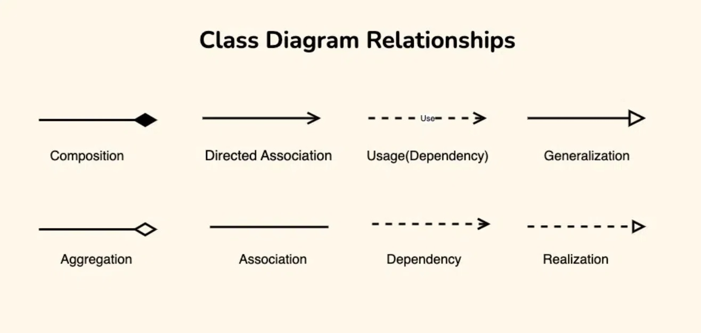
Class diagram
Has- a relation

Slide 12
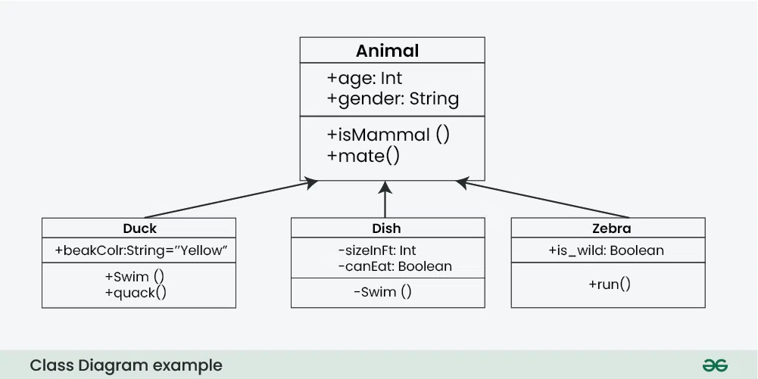
Class diagram

Slide 13
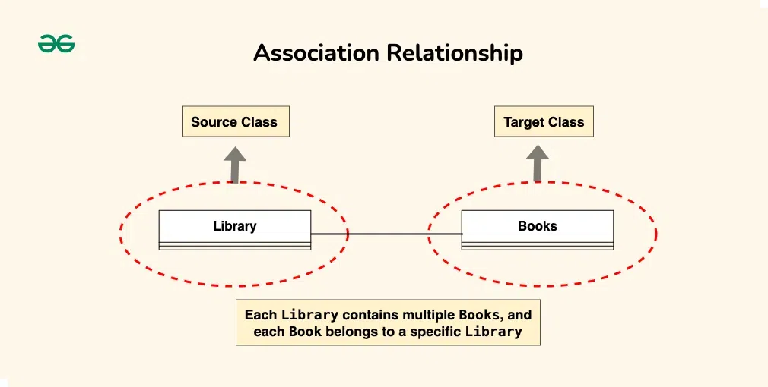
How to draw Class Diagram
An association represents a bi-directional relationship between two classes.

Slide 14
A directed association in a UML class diagram represents a relationship between two classes where the association has a direction, indicating that one class is associated with another in a specific way.

Slide 15
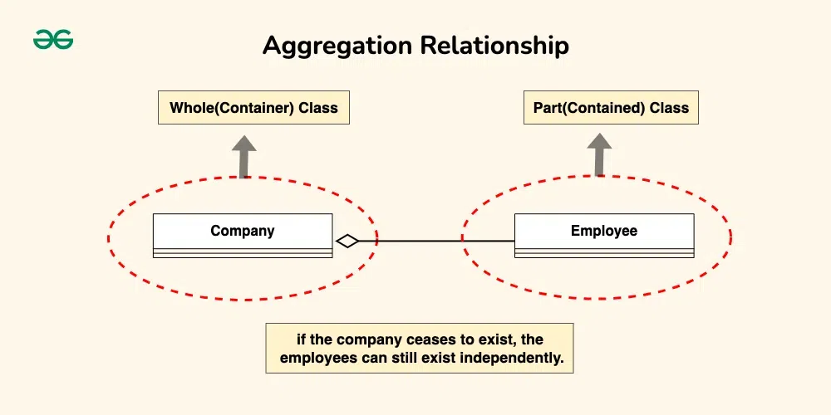
Aggregation is a specialized form of association that represents a “whole-part” relationship.
It denotes a stronger relationship where one class (the whole) contains or is composed of another class (the part).
Aggregation is represented by a diamond shape on the side of the whole class.
In this kind of relationship, the child class can exist independently of its parent class.

Slide 16
Composition is a stronger form of aggregation, indicating a more significant ownership or dependency relationship.
In composition, the part class cannot exist independently of the whole class.
Composition is represented by a filled diamond shape on the side of the whole class.

Slide 17
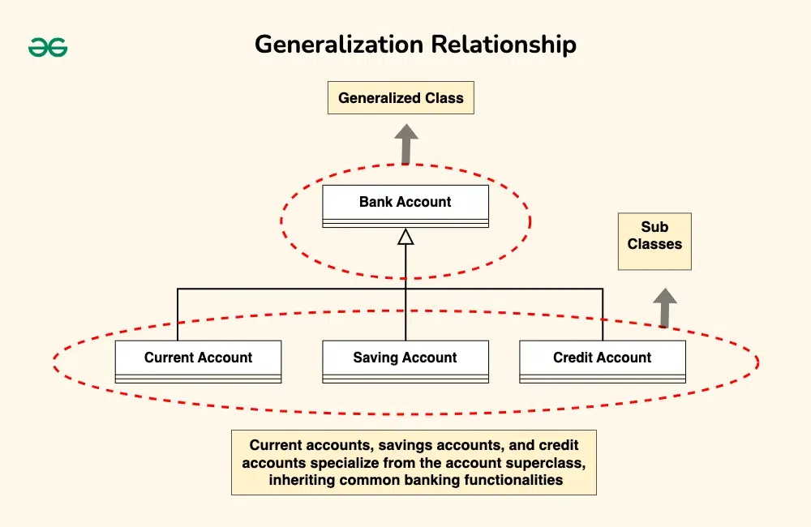
Generalization(Inheritance)
Inheritance represents an “is-a” relationship between classes, where one class (the subclass or child) inherits the properties and behaviors of another class (the superclass or parent).
Inheritance is depicted by a solid line with a closed, hollow arrowhead pointing from the subclass to the superclass.

Slide 18
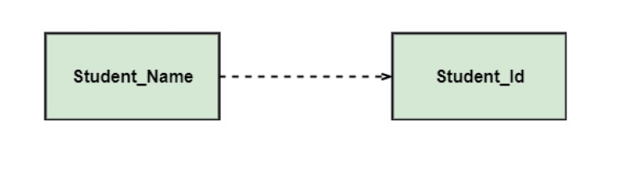
Dependency: A dependency is a semantic relationship between two or more classes where a change in one class cause changes in another class. It forms a weaker relationship.

Slide 19
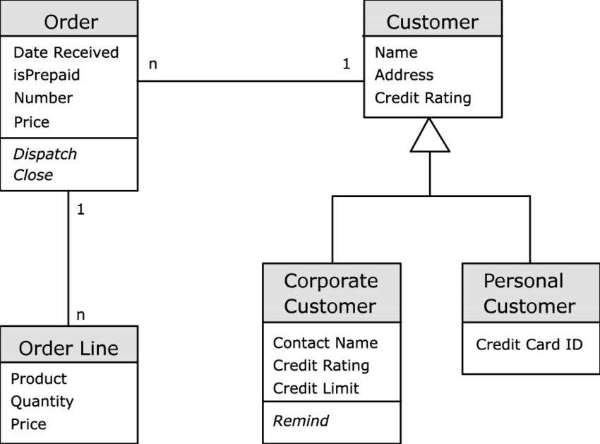

Slide 20
PART 2- Use Case
diagrams

Slide 21
Use Case diagrams
Use case diagrams model the behaviour of a system
Used to illustrate the functional requirements of the system and its interaction with external agents (actors).
A use case diagram gives us a high level view of the system without going into the implementation details.

Slide 22
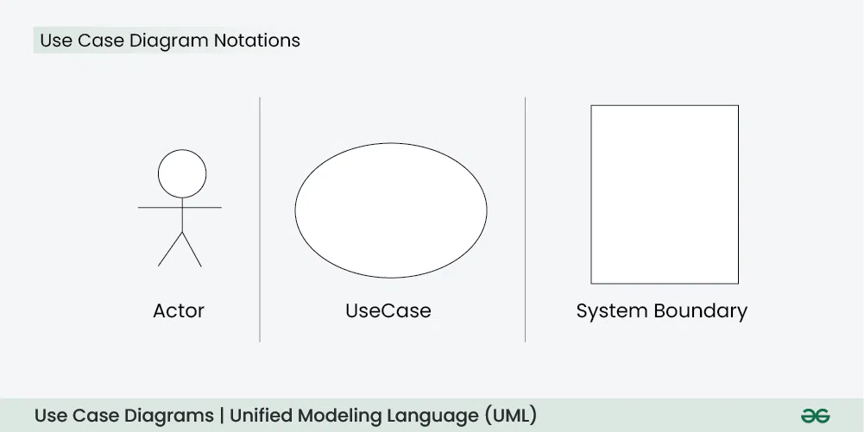
Use cases represent specific things your system can do.
In the online shopping system, examples of
use cases could be “Place Order,” “Track Delivery,” or
“Update Product Information”.
Use cases are represented by ovals.
Actors are external entities that interact with the system.
These can include users, other systems, or hardware devices
The system boundary is a visual representation of the scope or limits of the system you are modeling.
It defines what is inside the system and what is outside.

Slide 23
Use-case Diagram
The Association Relationship represents a communication or interaction between an actor and a use case,
The Include Relationship indicates that a use case includes the functionality of another use case
The Extend Relationship illustrates that a use case can be extended by another use case under specific conditions.

Slide 24
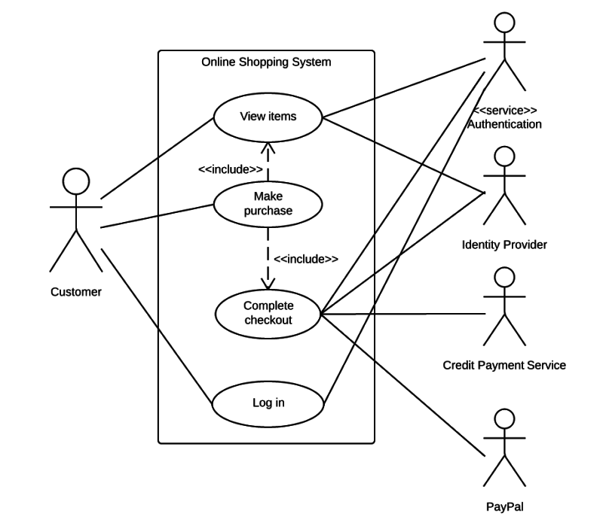
Use-case Diagram

Slide 25

Activity Diagram
It is also termed as an object-oriented flowchart.
Components of an Activity Diagram :-
Activities
The categorization of behavior into one or more actions is termed as an activity.
In other words, it can be said that an activity is a network of nodes that are connected by edges.
The edges depict the flow of execution. It may contain action nodes, control nodes, or object nodes.
The activities are initiated at the initial node and are terminated at the final node.

Slide 26
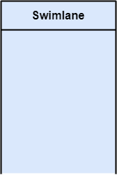
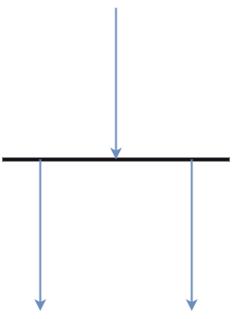
Activity Diagram
Activity partition /swimlane
The swimlane is used to cluster all the related activities in one column or one row. It can be either vertical or horizontal.
It used to add modularity to the activity diagram.
Forks
Forks and join nodes generate the concurrent flow inside the activity.
A fork node consists of one inward edge and several outward edges.
Whenever a data is received at an inward edge,
it gets copied and split crossways various outward edges.

Slide 27
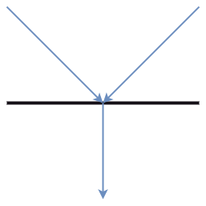
Activity Diagram
Join Nodes
Join nodes are the opposite of fork nodes.
A Logical AND operation is performed on all of the inward edges as it synchronizes the flow of input across one single output (outward) edge.

Slide 28
Activity Diagram
Following are the rules that are to be followed for drawing an activity diagram:
A meaningful name should be given to each and every activity.
Identify all of the constraints.
Acknowledge the activity associations.
Ex:An example of an activity diagram showing the business flow activity of order processing is given below.

Slide 29
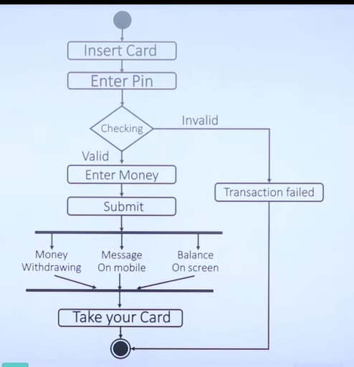
Activity Diagram

Slide 30
interaction diagram
interaction diagram portrays the interactions between distinct entities present in the model. (or)
an interaction diagram used to capture the interactive behavior of a system.
Interaction diagrams focus on describing the flow of messages within a system, providing context for one or more lifelines within a system.
In addition, interaction diagrams can be used to represent the ordered sequences within a system and act as a means of visualizing real-time data via UML.

Slide 31
interaction diagram
Benefits of using an interaction diagram
Model a system as a time-ordered sequence of events.
Reverse- or forward-engineer a system or process.
Organize the structure of various interactive events.
Simply convey the behavior of messages and lifelines within a system.
Identify possible connections between lifeline elements.
Interaction diagrams are divided into four main types of diagrams:
Communication diagram
Sequence diagram
Timing diagram
Interaction overview diagram
Each type of diagram focuses on a different aspect of a system’s behavior or structure.

Slide 32
Sequence diagram
It has two components
The objects, e.g., customer, waiter, chef in a restaurant
Interaction among them in a timely manner.
Basically shows the sequence of events.
Request in a sequence diagram is represented with a solid line and the response in represented as a dotted line
It portrays the communication between any two lifelines as a time-ordered sequence of events, such that these lifelines took part at the run time.

Slide 33
Sequence Diagram
Actor
It represents the role, which involves human users and external hardware or subjects.
An actor may or may not represent a physical entity, but it purely depicts the role of an entity. Several distinct roles can be played by an actor or vice versa.
Activation
It is represented by a thin rectangle on the lifeline.
It describes that time period in which an operation is performed by an
element, such that the top and the bottom of the rectangle is associated
with the initiation and the completion time, each respectively.

Slide 34
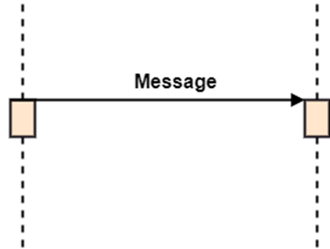
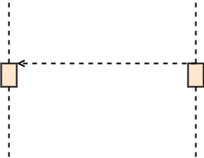
Sequence Diagram
Messages
The messages depict the interaction between the objects and are represented by arrows.
They are in the sequential order on the lifeline. The core of the sequence diagram is formed by messages and lifelines.
Call Message: It defines a particular communication between the lifelines of an interaction, which represents that the target lifeline has invoked an operation.
Return message:

Slide 35
Sequence Diagram
Creation
Create message
Object life starts at that point
Activation
Symbolized by rectangular stripes
Place on the lifeline where object is activated.
Rectangle also denotes when object is deactivated.
Deletion
Placing an ‘X’ on lifeline
Object’s life ends at that point

Slide 36
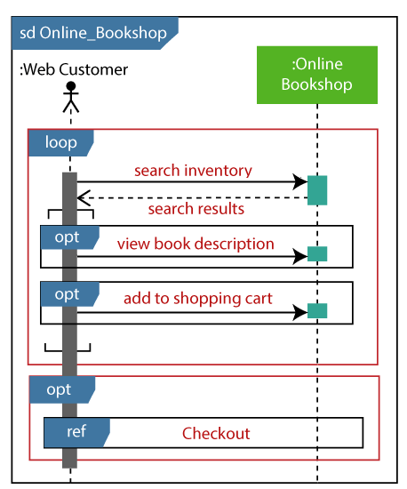
Sequence Diagram

Slide 37
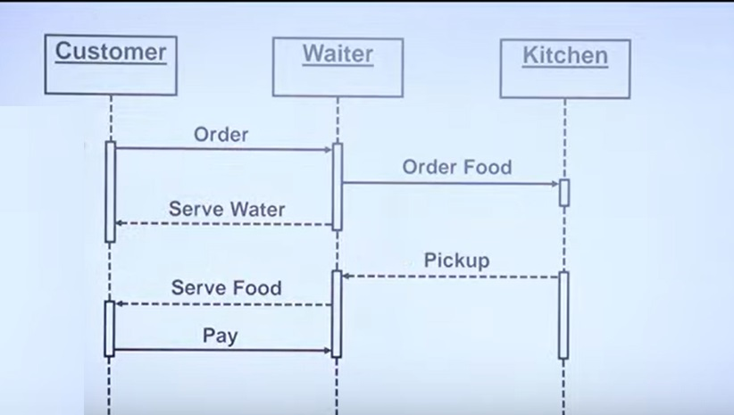
Sequence diagram

Slide 38
Communication diagram
Communication diagram (or collaboration diagram)
communication diagrams depict the relationships and interactions among various software objects.
They emphasize the structural aspects of an interaction diagram, focusing on object architecture rather than the flow of messages.

Slide 39
